Slide 1

Working with Assistants Part 2: Creating Assistants

Slide 2
Alexander Lee
“Michelangelo continually had trouble with his assistants and had to sack several for poor workmanship, laziness, or even - in one particular case - because the lad in question was 'a stuck-up little turd’.”

Slide 3



Notes:
https://www.youtube.com/channel/UC35ZpwldGw7ZJ5R-2sLijzw

Slide 4
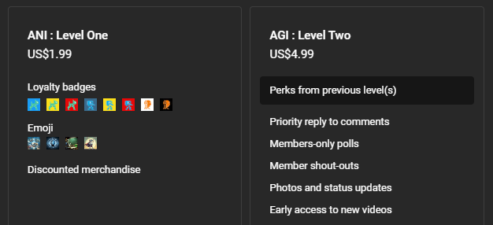

Membership has its privileges
Notes:
https://www.youtube.com/channel/UC35ZpwldGw7ZJ5R-2sLijzw/join

Slide 5
Creating Assistants With Code
Read a Lot of Code, Write a Lot of Code
Notes:
https://platform.openai.com/docs/api-reference/assistants/createAssistant

Slide 6
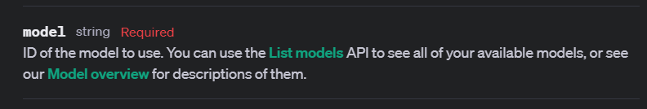
The Only Required Parameter
Notes:
https://platform.openai.com/docs/api-reference/assistants/createAssistant#assistants-createassistant-model

Slide 7
Demo: Creating a Minimalist Assistant
from openai import OpenAI
client = OpenAI()
assistant = client.beta.assistants.create(
model="gpt-4-turbo",
)

Slide 8
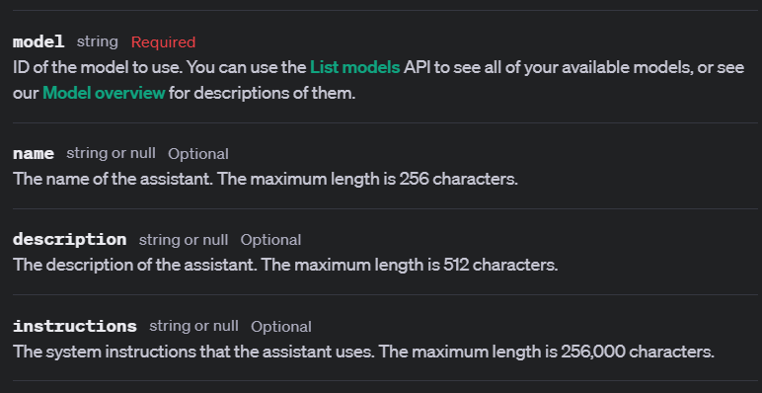
Basic “Required” Arguments
Notes:
https://platform.openai.com/docs/api-reference/assistants/createAssistant

Slide 9
Demo: Creating a Basic Assistant
from openai import OpenAI
client = OpenAI()
assistant = client.beta.assistants.create(
model="gpt-4-turbo",
name="Seriously Cool Assistant",
description="This is a seriously cool assistant",
instructions="You are a helpful assistant.",
)

Slide 10
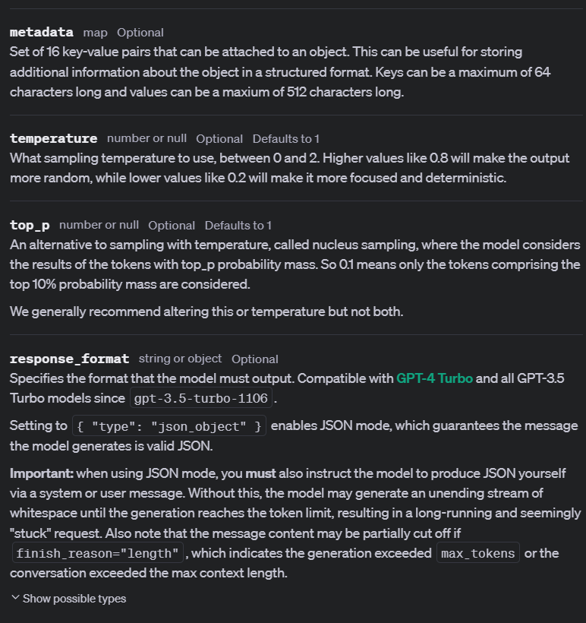
Additional Arguments
Notes:
https://platform.openai.com/docs/api-reference/assistants/createAssistant

Slide 11
Demo: Additional Arguments
assistant = client.beta.assistants.create(
model="gpt-4-turbo",
name="Extra Arguments Assistant",
description="This assistant has extra arguments",
instructions="You are a helpful assistant.",
metadata={
"key": "value",
"IsAwesome": "True",
"IsBeta": "False"
},
temperature=1,
top_p=1,
response_format="auto",
)

Slide 12
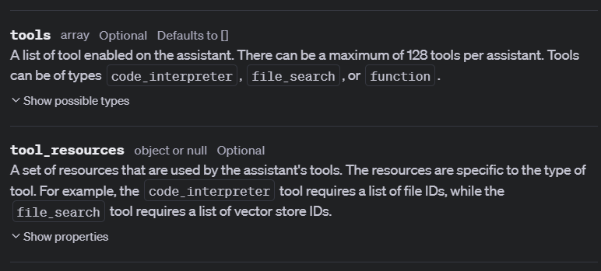
Identifying Tools
Notes:
https://platform.openai.com/docs/api-reference/assistants/createAssistant#assistants-createassistant-tools

Slide 13
Demo: Identifying Tools
from openai import OpenAI
client = OpenAI()
assistant = client.beta.assistants.create(
instructions="You are a personal data analyst. When asked a question, write and run Python code to answer the question.",
name="Code Interpreter Assistant",
metadata={
"key": "value",
"IsAwesome": "True",
"IsBeta": "False"
},
temperature=1,
top_p=1,
response_format="auto",
tools=[{"type": "code_interpreter"}],
tool_resources=None,
model="gpt-4-turbo",
)

Slide 14
